Slide 1
Human Development Index (HDI)

Slide 2
Understanding Indexes
What is an index?
An index is a composite of indicators that produces a single calculation which can then be ranked.

Slide 3

The Human Development Index (HDI)
…is the best known composite index of social and economic well-being…

Slide 4

The Concept of Human Development
"The basic purpose of development is to enlarge people's choices. In principle, these choices can be infinite and can change over time. People often value achievements that do not show up at all, or not immediately, in income or growth figures: greater access to knowledge, better nutrition and health services, more secure livelihoods, security against crime and physical violence, satisfying leisure hours, political and cultural freedoms and sense of participation in community activities. The objective of development is to create an enabling environment for people to enjoy long, healthy and creative lives."
Mahbub ul Haq -- Founder of the Human Development Report

Slide 5
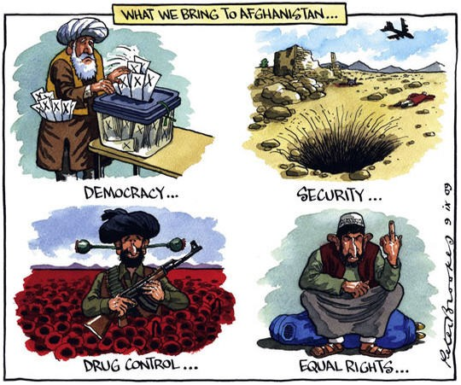

Calculating HDI: New Method
Indicator that measures the overall development of a nation; Life expectancy at birth, longevity, Education, Income
It is the statistic used to rank countries by level of standard of living and quality of life.
It goes from 0 to 1 ( 1 –most ; 0- worst)

Slide 6
Components of HDI
Life expectancy at birth: Number of years a newborn infant could expect to live if prevailing patterns of age-specific mortality rates at the time of birth stay the same throughout the infant’s life.
Mean years of schooling: Average number of years of education received by people aged 25 and older, converted from education attainment levels using official durations of each level.
Expected years of schooling: Number of years of schooling that a child of school entrance age can expect to receive if prevailing patterns of age-specific enrolment rates persist throughout the child’s life.

Slide 7
Contd..
Gross national income (GNI) per capita: Aggregate income of an economy generated by its production and its ownership of factors of production, less the incomes paid for the use of factors of production owned by the rest of the world, converted to international dollars using purchasing power parity (PPP) rates, divided by midyear population.

Slide 8
Contd..
Human Development Index (HDI): A composite index measuring average achievement in three basic dimensions of human development—a long and healthy life, knowledge and a decent standard of living.

Slide 9
Calculating Human Development Index
The Human Development Index (HDI) is a summary measure of human development.
It measures the average achievements in a country in three basic dimensions of human development: a long and healthy life, access to knowledge and a decent standard of living.
The HDI is the geometric mean of normalized indices measuring achievements in each dimension.

Slide 10
Steps to estimate the Human Development Index
Step 1. Creating the dimension indices
Minimum and maximum values (goalposts) are set in order to transform the indicators into indices between 0 and 1.
These goalposts act as the ‘natural zeroes’ and ‘aspirational goals’, respectively, from which component indicators are standardized

Slide 11
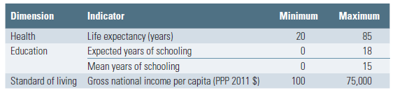
Goal Posts

Slide 12
Goal Posts Contd..
The justification for placing the natural zero for life expectancy at 20 years is based on historical evidence.
Societies can subsist without formal education, justifying the education minimum of 0 years.
The maximum for mean years of schooling, 15, is the projected maximum of this indicator for 2025.
The maximum for expected years of schooling, 18, is equivalent to achieving a master’s degree in most countries.

Slide 13
Goal Posts Contd..
The low minimum value for gross national income (GNI) per capita, $100, is justified by the considerable amount of unmeasured subsistence and nonmarket production in economies close to the minimum, which is not captured in the official data.
The maximum is set at $75,000 per capita.
Kahneman and Deaton (2010) have shown that there is a virtually no gain in human development and well-being from annual income beyond $75,000.

Slide 14
the sub indices are calculated as follows:

Slide 15
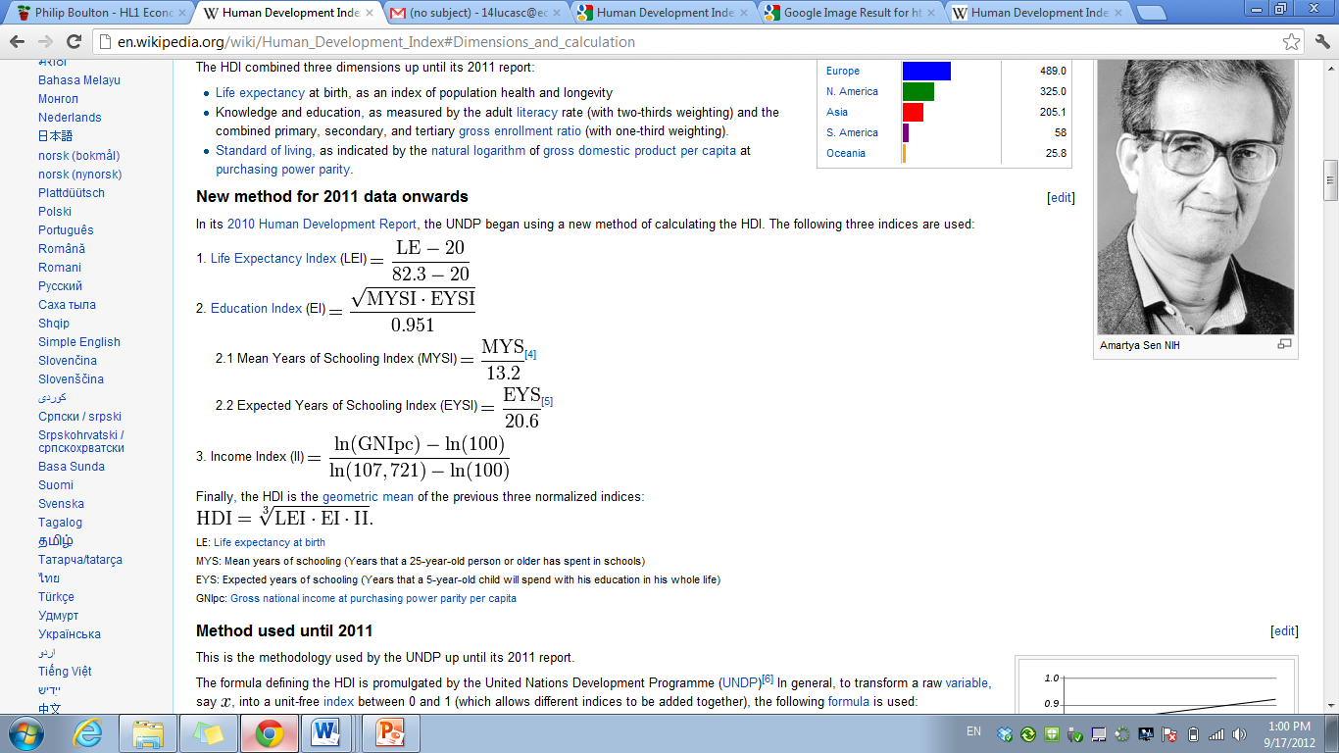
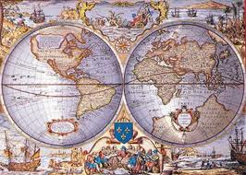
How is the HDI calculated?
LEI = Life Expectancy Index
EI = Education Index
II = Income Index

Slide 16
Formula for HDI calculation
Life Expectancy Index (LEI) =
Education Index (EI) = (MYSI + EYSI)/2
MYSI = MYS/15
EYSI = EYS/18
Income Index (II) =
Finally, the HDI is the geometric mean of the previous three normalized indices:

Slide 17
Methodology used to express income
The World Bank’s 2014 World Development Indicators database contains estimates of GNI per capita in 2011 purchasing power parity (PPP) terms for many countries.
For countries missing this indicator, the Human Development Report Office calculates it by converting GNI from current to constant terms using two steps.
First, the value of nominal GNI per capita is converted into PPP terms for the base year (2011).
Second, a time series of GNI per capita in 2011 PPP terms is constructed by applying the real growth rates to the GNI per capita in PPP terms for the base year.
The real growth rate is implied by the ratio of the nominal growth of current GNI per capita in local currency terms to the GDP deflator.

Slide 18
Purchasing Power Parity (PPP) $
Official PPP conversion rates are produced by the International Comparison Program, whose surveys periodically collect thousands of prices of matched goods and services in many countries.
The last round of this exercise refers to 2011 and covered 180 countries.

Slide 19
Is the HDI Enough to Measure a Country’s Level of Development?
According to the UNDP, the answer is:
“Not at all.”
“The concept of human development is much broader than what can be captured in the HDI, or any other composite indices…”
“The HDI and the other composite indices can only offer a broad proxy on some of the key issues of human development…”
“A fuller picture of a country's level of human development requires analysis of other human development indicators and information.”
Notes:
Is the HDI enough to measure a country’s level of development?
According to the UNDP website, the answer is no, but: http://hdr.undp.org/en/statistics/faq/question,70,en.html
But HDI is definitely better than GDP.
http://hdr.undp.org/en/statistics/faq/question,71,en.html
Ultimately, the concept of human development is much broader than what can be captured in the HDI, or any other composite index. The HDI, for example, does not reflect political participation or gender inequalities. The HDI and the other composite indices can only offer a broad proxy on some of the key issues of human development. A fuller picture of a country's level of human development requires analysis of other human development indicators and information.
It is worth asking students what indicators they would include if they were to create their own human development index (Note: this is one of the exercises that comes at the end of this presentation).

